Slide 1
Chapter 29 Notes

Slide 2
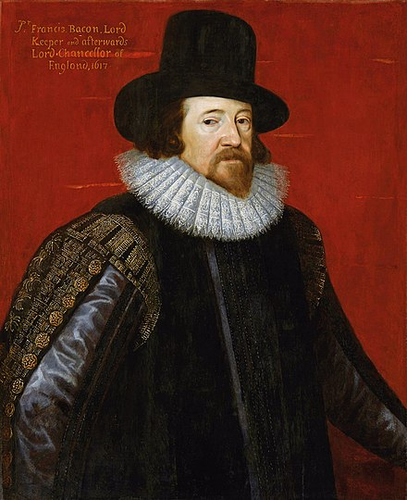
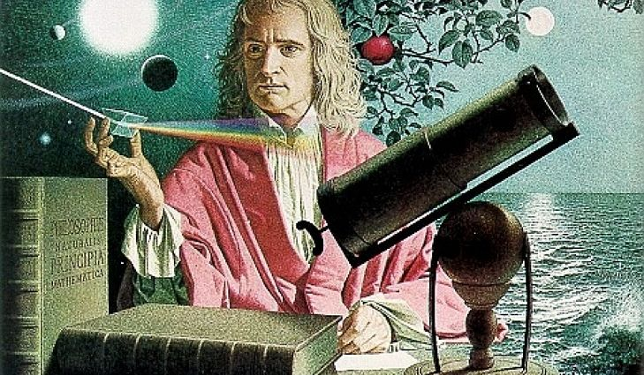
Scientific Revolution
16th-17th centuries (1500-1600 CE)
Emergence of Modern Science
Empirical evidence
Experimentation
Scientific method
The universe is governed by Natural Laws
Influenced and inspired the Enlightenment

Slide 3
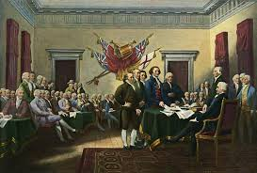
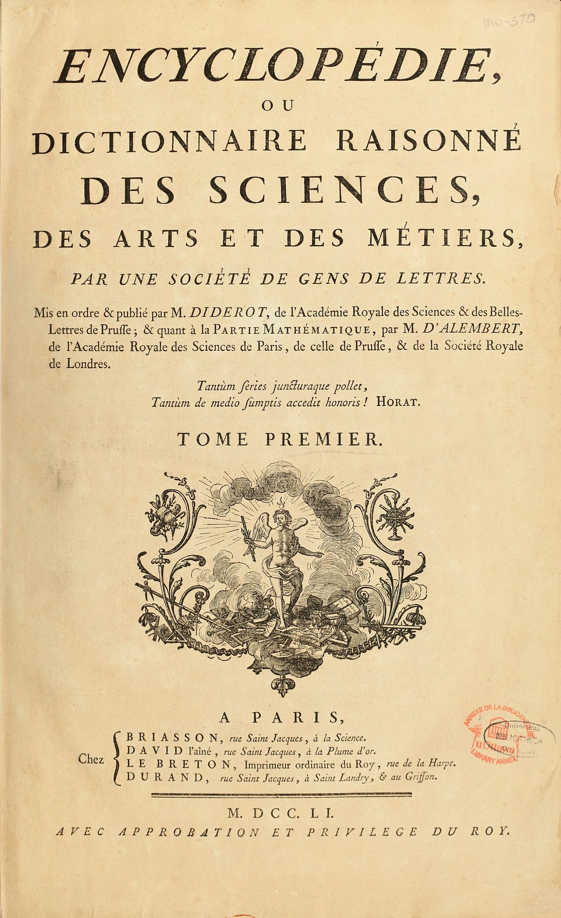
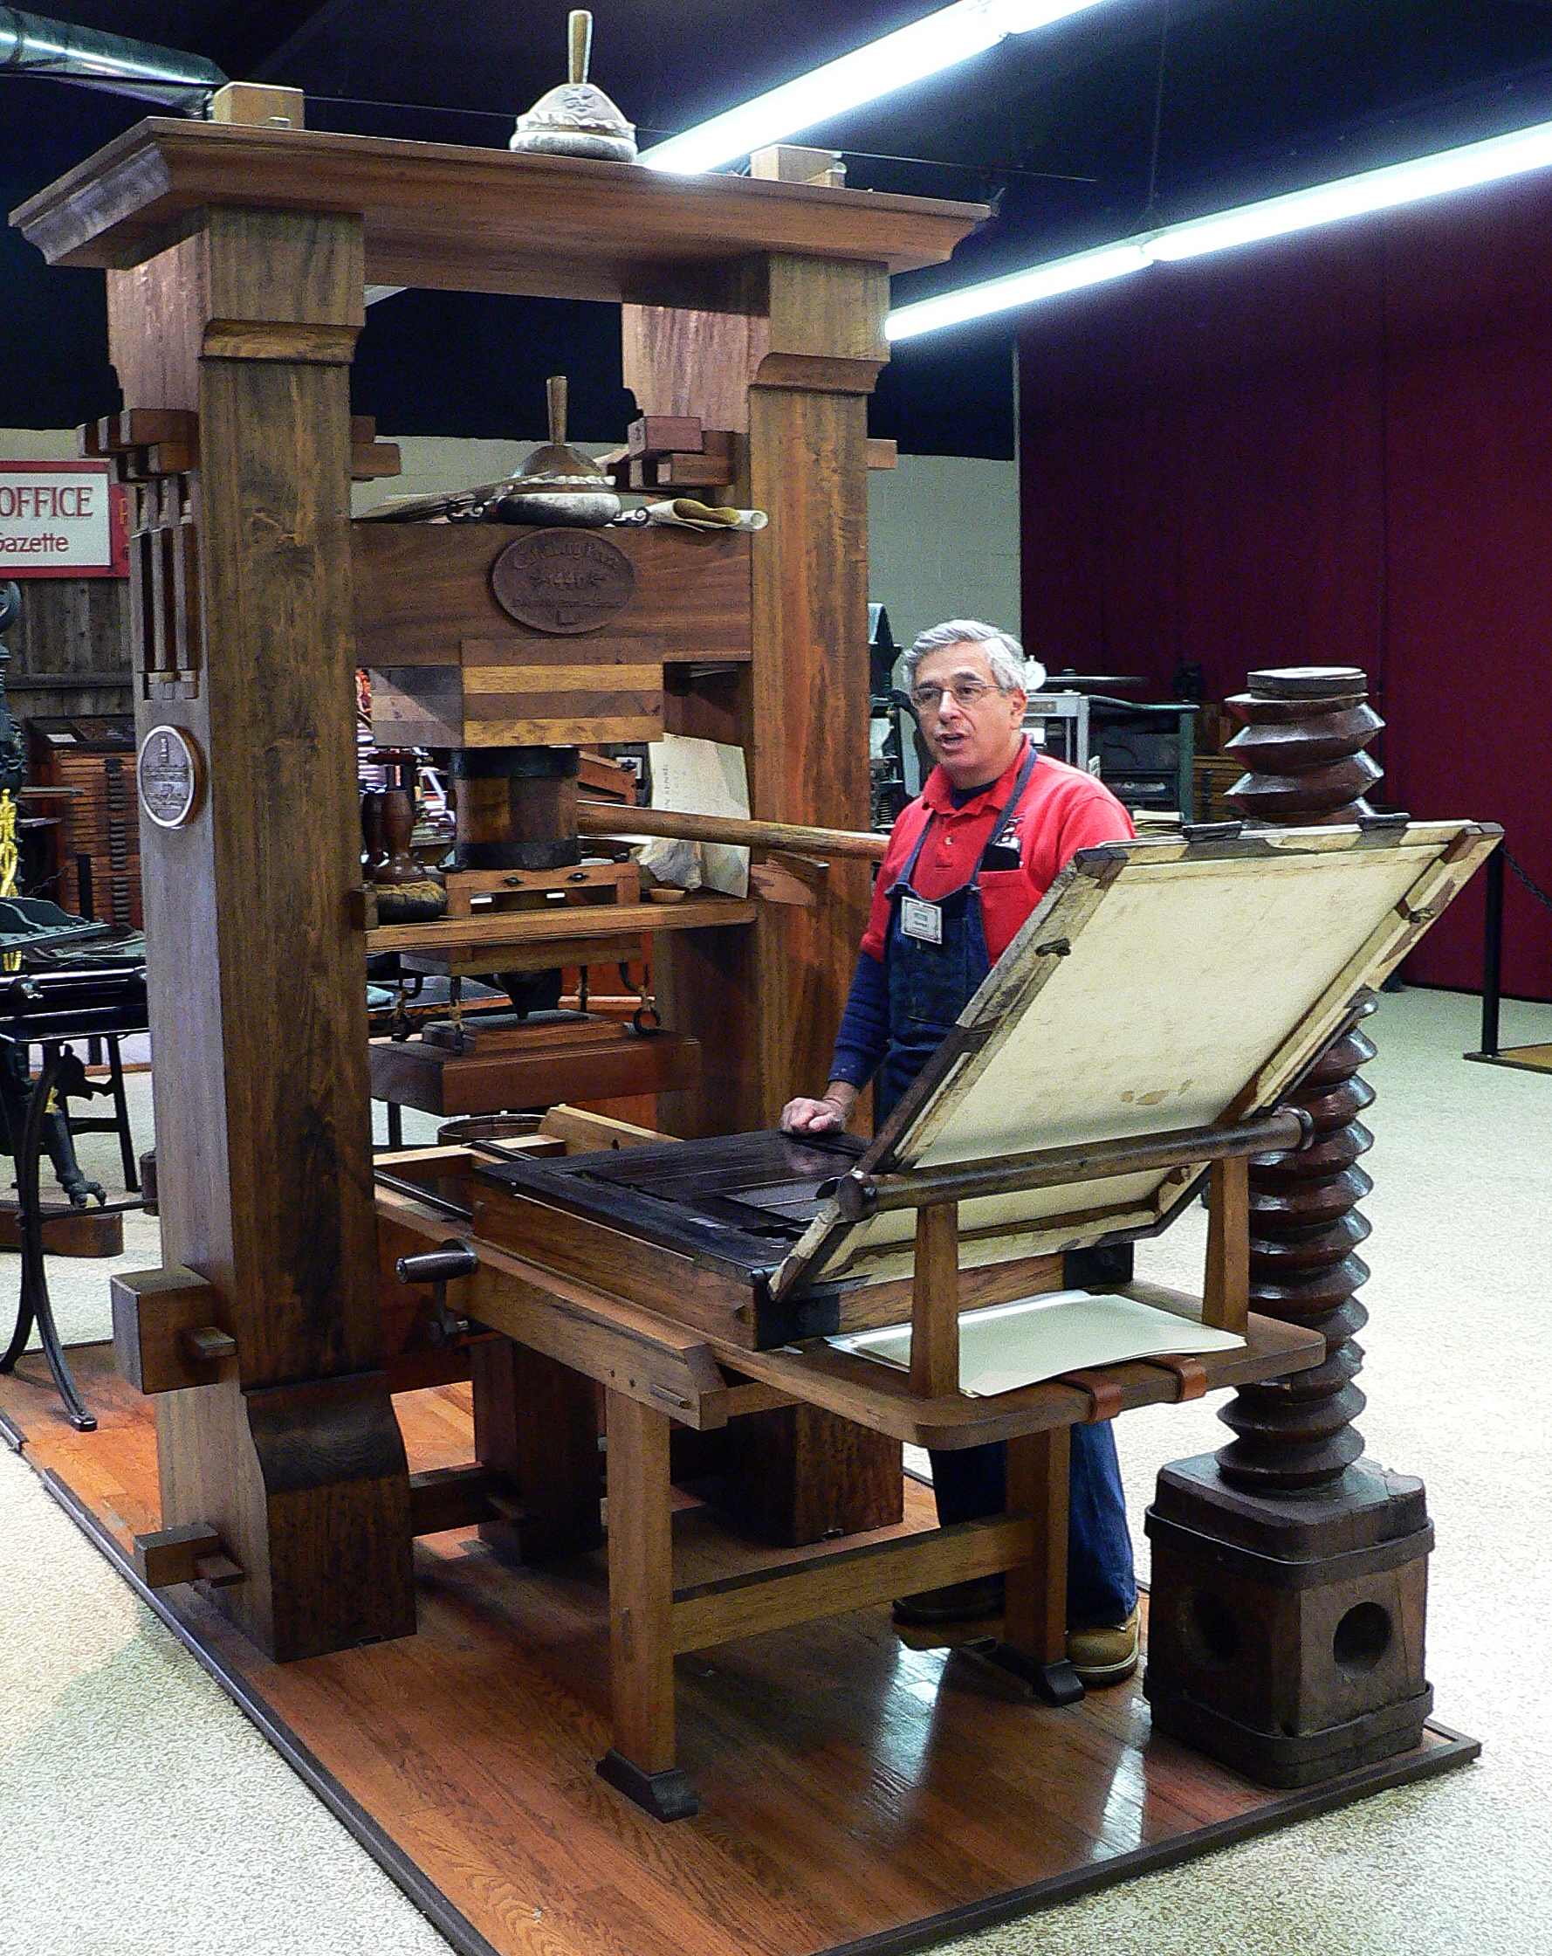
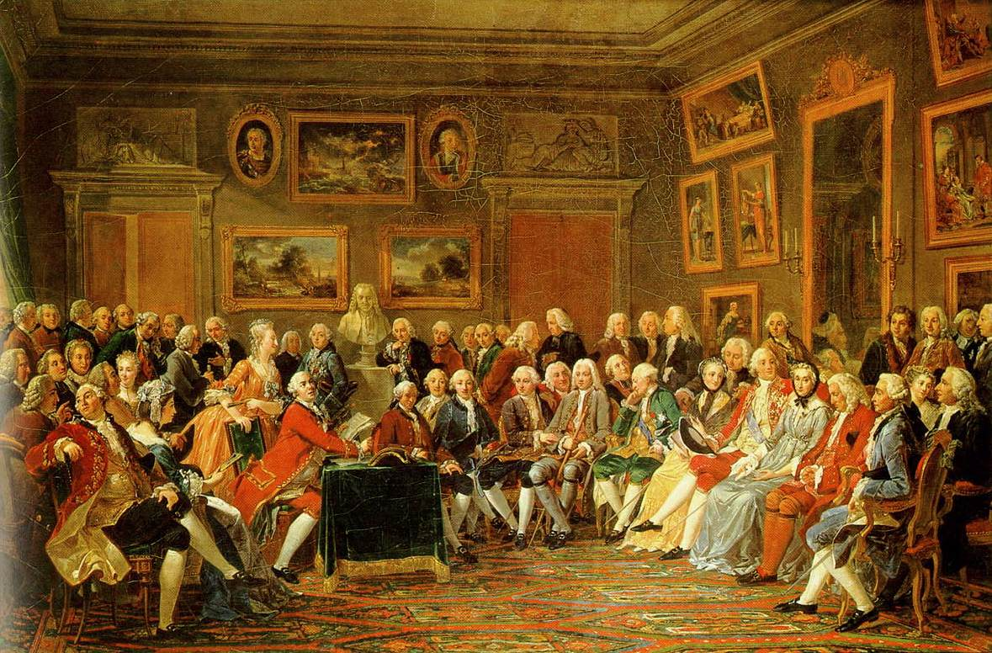
The Enlightenment
17th-18th centuries
The Age of Reason
Inspired by Scientific Revolution
Natural Laws for humans?
Philosophes
John Locke – natural rights
Voltaire – freedom of speech; religion
Rousseau – social contract
Challenges tradition
Absolute rule
The Catholic church
Slavery

Slide 5
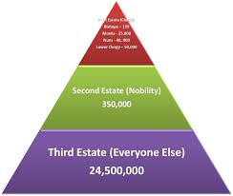

Slide 6
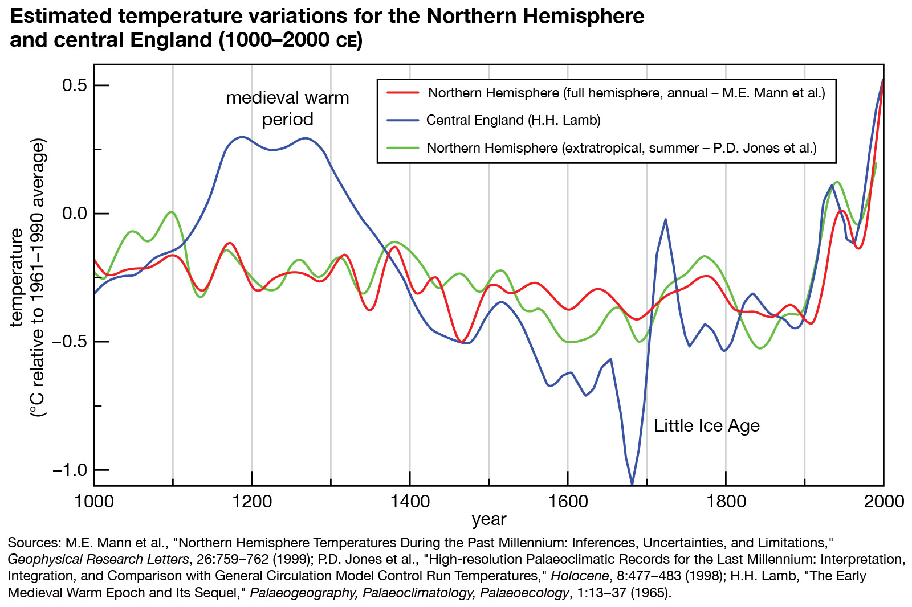
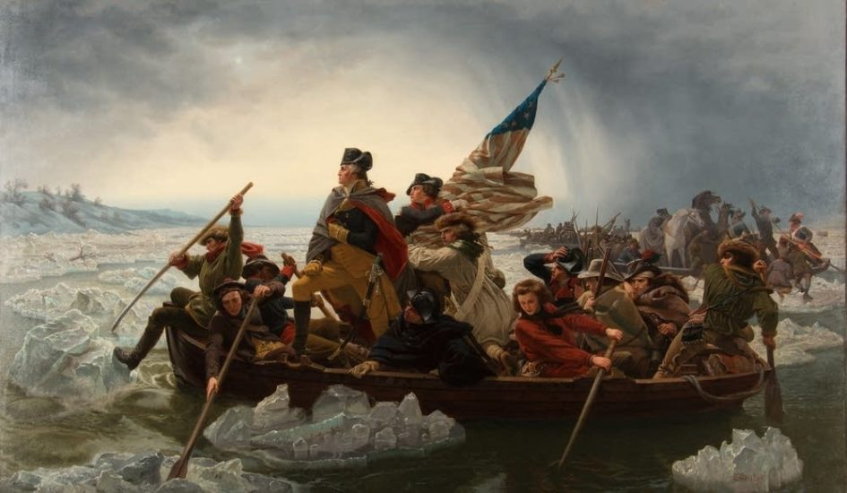
French Revolution: CAUSES
Estate-System – Ancien Regime
1st Estate: Catholic church
2nd Estate: Nobles
3rd Estate: Everyone else (peasants, Bourgeoisie)
Famine – climate change
The Little Ice Age

Slide 7
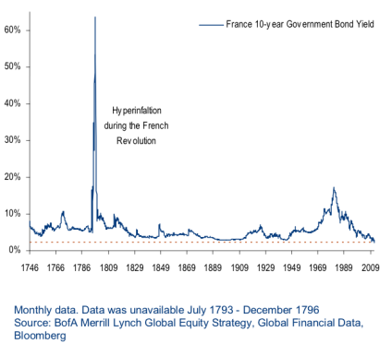
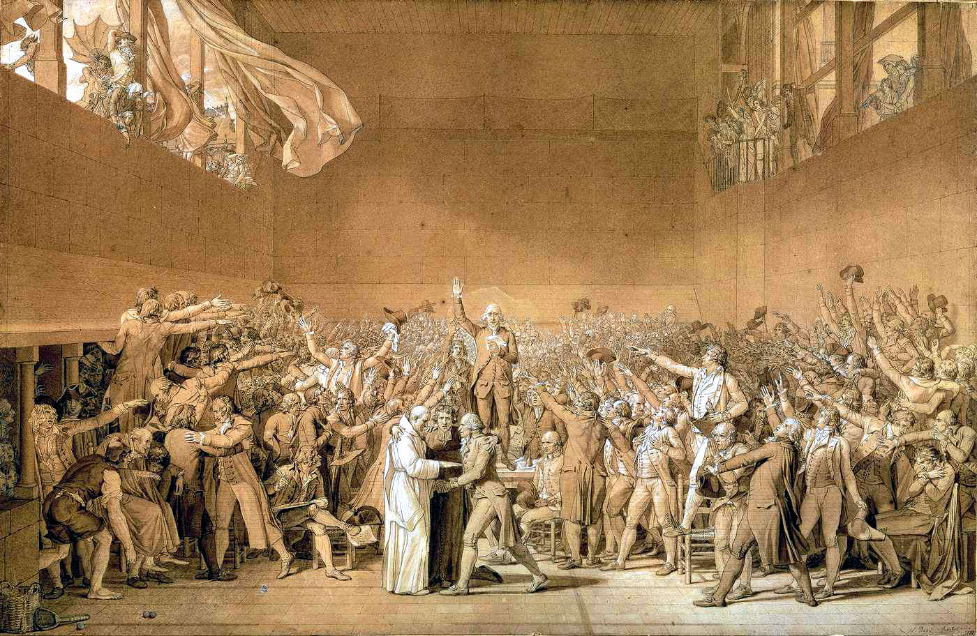
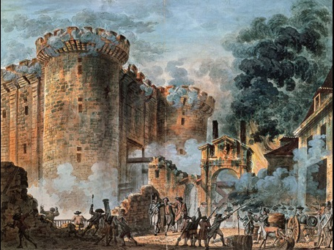
French Revolution: CAUSES
Economic – deficit spending
Excesses of Versailles
Wars (7-years war; American Revolution)
Leadership
King Louis XVI
Estates-General meeting
Tennis Court Oath
Storming of the Bastille July, 1789
Begins revolution

Slide 8
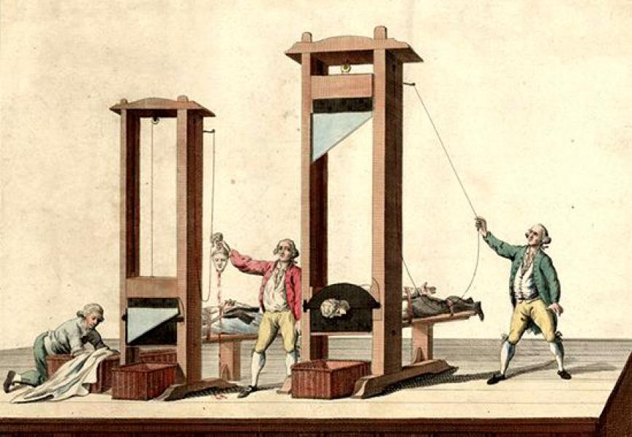
Phases of the French Revolution 1789-1815
National Assembly – 1st phase
Abolishes estate-system
Declaration of the Rights of Man
National Convention – 2nd phase
Radicals (Jacobins, Sans-Culottes)
Execution of Louis XVI
New Constitution – Republic
War…with everyone!
Reign of Terror
Directory – 3rd phase
Ineffective
Napoleon – 4th phase
Napoleonic code
Concordat of 1801
Continental system
Downfall – Russia; Waterloo
Congress of Vienna
Restores monarchies (legitimacy)
Balance of power
Rise of Nationalism

Slide 9
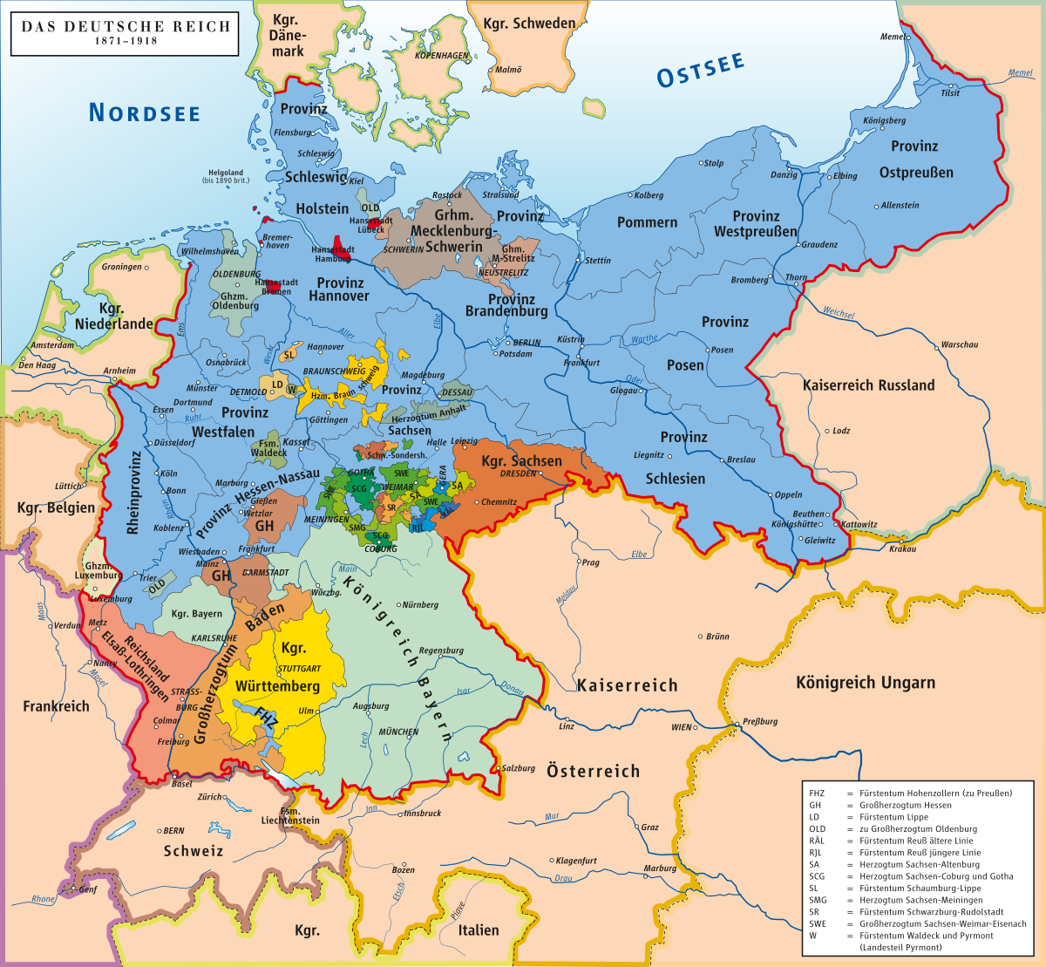
Nationalism
Nation = a large body of people united by common descent, history, culture or language
State = a political community under one government
Nation-State versus Multiethnic State
France, Spain, Japan
United States, Canada, United Kingdom
Nationalism = strong pride in one’s nation
Propaganda and compulsory education

Slide 10
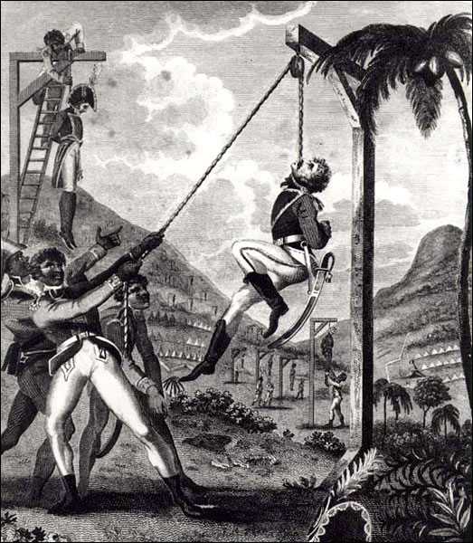
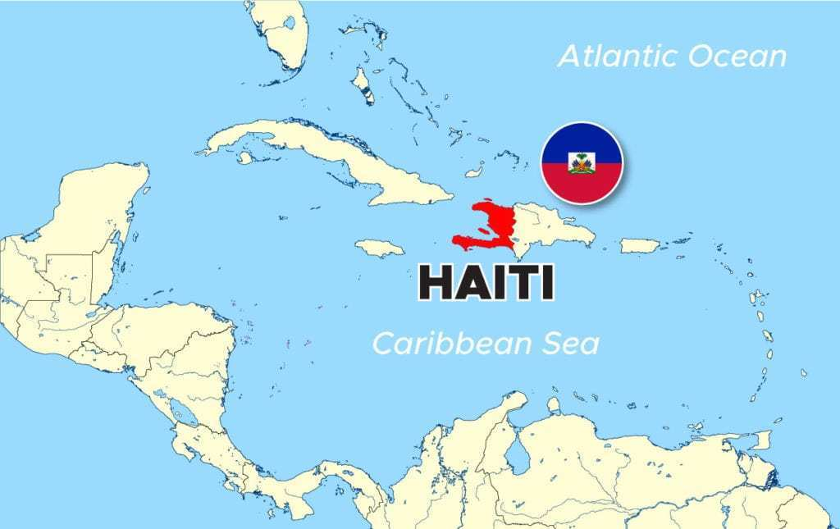
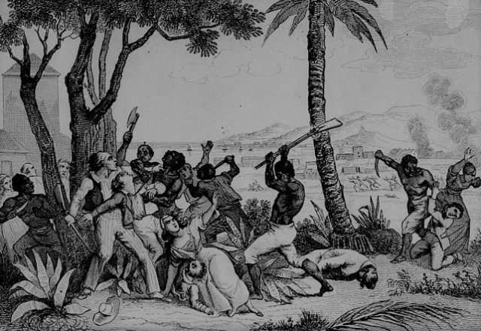
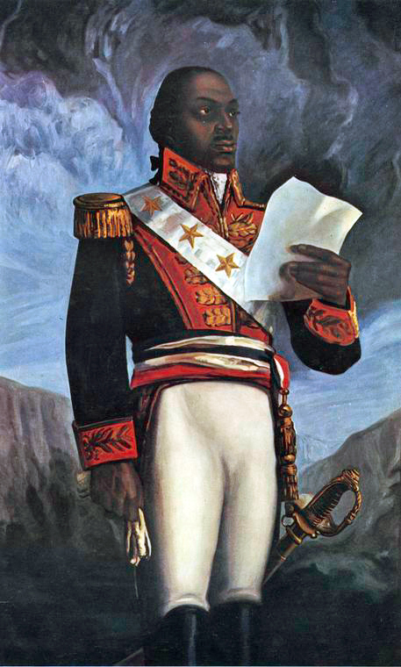
Haitian Revolution 1791-1804
Colonized by France – St. Domingue
Sugar, coffee, cotton – Atlantic Triangular Slave Trade (richest colony)
Brutality
Disproportionately high slave population (maroons)
40,000 white settlers, 30,000 Gens de Couleur, 500,000 slaves
Gens de Couleur return from war and lead revolution
Toussaint Louverture
Only successful slave revolt
Desired egalitarian society

Slide 11
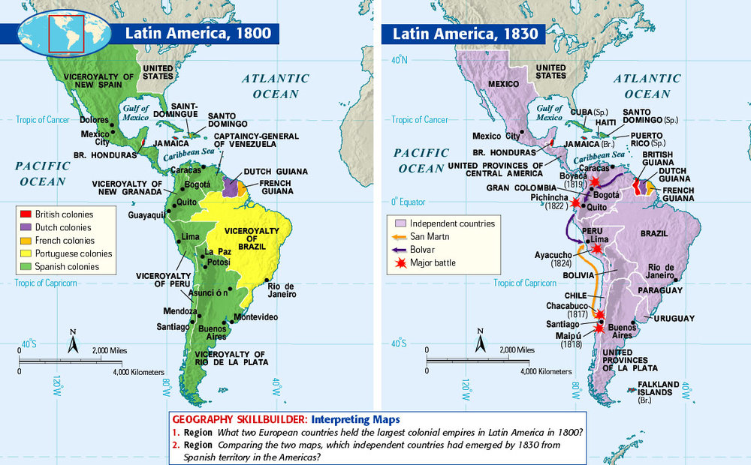
Latin American Revolutions
Population by 1800 in Latin America
Peninsulares 30,000 (governed)
Creoles 3.5-million
Mestizos, Mulattos, Natives, Slaves 10-million
Unlike French, Haitian or American Revolutions
Mestizos simply wanted to replace Peninsulares
Napoleon
Most of Latin America gains independence
Society remined rigidly stratified

Slide 12
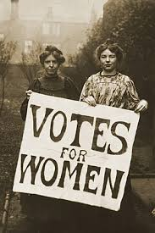
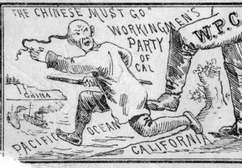
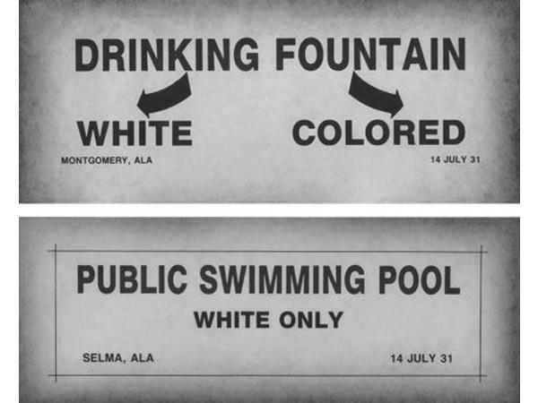
Freedom without Equality
Women
Olympe de Gouges
Declaration of the Rights of Woman and the Citizen
Mary Wollstonecraft
Elizabeth Cady Stanton
Seneca Falls Conference
Former slaves
African Americans
Latin America
Mestizos, Mulattos
Native Americans
Immigrants
Religions

